Slide 1
Types of Linked List (Data Structure)
There are four types of Linked List in Data Structures which are discussed below-
Singly Linked list
Doubly Linked list
Circular Linked list
Doubly Circular Linked list

Slide 2
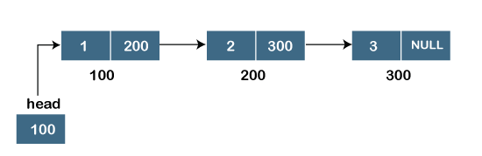
1) Singly Linked List
It is the commonly used linked list in programs. If we are talking about the linked list, it means it is a singly linked list.

Slide 3
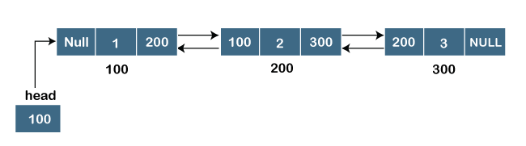
2) Doubly Linked List
A doubly linked list is a list that has three parts in a single node, includes one data part, a pointer to its previous node, and a pointer to the next node.
Code:
struct node
{
int data;
struct node *next;
struct node *prev;
} ;

Slide 4
3) Circular Linked List
A circular linked list is a variation of a singly linked list. The only difference between the singly linked list and a circular linked list is that the last node does not point to any node in a singly linked list, so its link part contains a NULL value. On the other hand, the circular linked list is a list in which the last node connects to the first node, so the link part of the last node holds the first node's address. The circular linked list has no starting and ending node. We can traverse in any direction, i.e., either backward or forward.

Slide 5
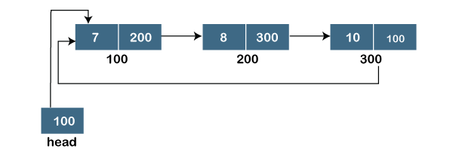
representation of the circular linked list is shown below:
Code:
struct node
{
int data;
struct node *next;
} ;

Slide 6
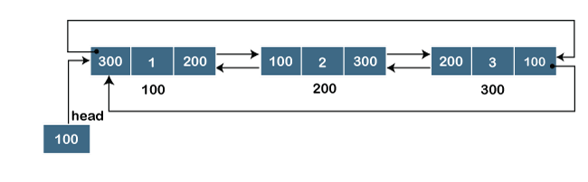
4) Circular Doubly Linked List
The doubly circular linked list has the features of both the circular linked list and doubly linked list.
Code:
struct node
{
int data;
struct node *next;
struct node *prev;
} ;

